Slide 1



Auto-Remediation: Building an Unbreakable Delivery Pipeline
Andreas Grabner
DevOps Activist
Dynatrace
Florian Beck
Technical Product Manager
Dynatrace
Travis DePuy
Product Evangelist
xMatters

Slide 2
Pre-Requisits

Slide 3
What we asked from you
Deploying Applications on AWS
Have their own AWS Account where you have full privileges or sign up @ https://aws.amazon.com/free/. We will hand out AWS Vouchers
Install the tools required to remote into a remote Linux machine as explained here: https://docs.aws.amazon.com/AWSEC2/latest/UserGuide/AccessingInstances.html
Install and configure the AWS CLI: https://docs.aws.amazon.com/cli/latest/userguide/cli-chap-getting-started.html
Install a Git Client and a GitShell for your Windows or Linux laptop
Make sure you have a good text editor on your machine. We will be editing JSON, YAML and JavaScript files in this exercise
We need a modern browser to access your AWS Account and a Dynatrace SaaS Tenant that we will provide. We suggest to have the latest version of Chrome installed
We need a Zip tool as we are zipping up application source code directories and upload it to S3
Everything we need for our xMatters Integration
Register for an xMatters Free Trial. The xMatters trial will be extended to make sure you can keep using it throughout and after PERFORM: https://www.xmatters.com/p1/xmatters-trial-it-standard?utm_campaign=70138000001F018AAC&utm_source=dyna&utm_medium=email&utm_content=xmatters-trial
Download the xMatters / Dynatrace Communication Plan: https://github.com/xmatters/xm-labs-dynatrace/raw/master/Dynatrace.zip
Look at the attached slides on xMatters. Follow the instructions as good as you can and make yourself familiar with xMatters and how to configure the integration. We will run through it at the HOTDAY using the Dynatrace SaaS Tenant we assign to you. Making yourself familiar with the steps upfront will speed up the exercise

Slide 4
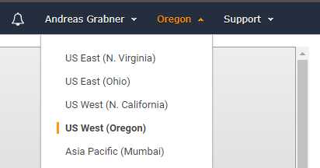
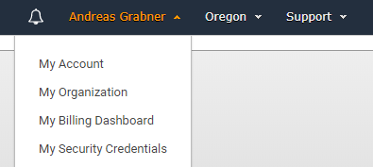
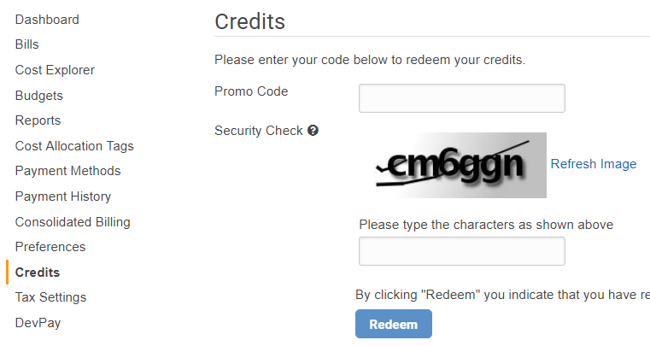
Prerequisites: AWS with Dynatrace
Download: https://github.com/Dynatrace/AWSDevOpsTutorial
Login to your AWS Account: http://aws.amazon.com
For our HOTDAY we will operate in US-West-2 (Oregon)
Make sure you SWITCH to that region
Now to go My Billings Dashboard and redeem your AWS Voucher
Login to: https://TENANT.sprint.dynatracelabs.com
Login with your student it on your card
#3
#1
#2
#4

Slide 5
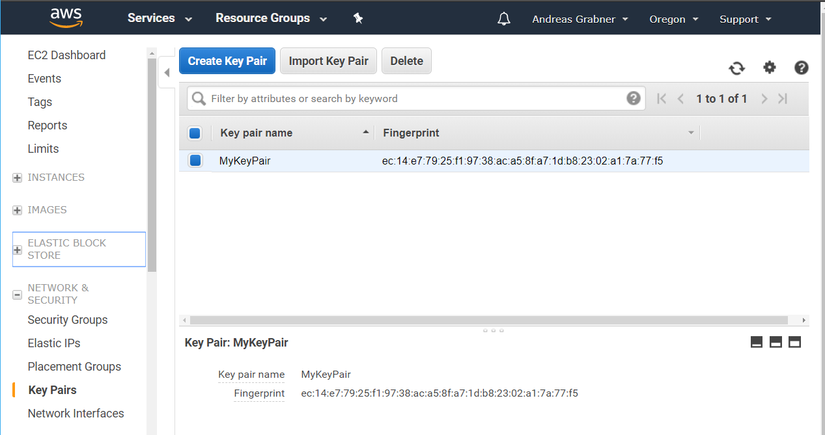
#1 - Prerequisites Sanity Check: AWS
Create EC2 Key Pair
Go to EC2 – Pich Region Oregon
Click on Key Pair
Create a new Pair
Store the .pem file

Slide 6
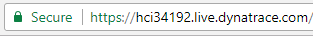
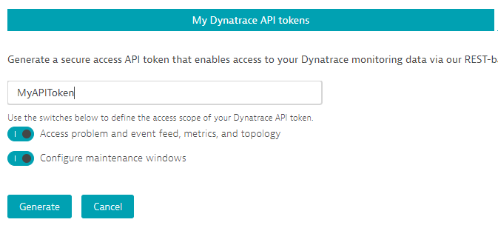
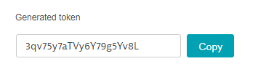
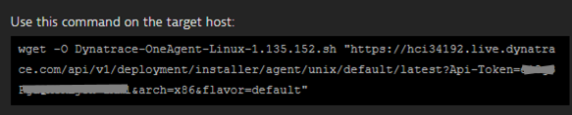
#2 - Prerequisites Sanity Check: Dynatrace
Login to your Dynatrace SaaS Trial we just gave you: http://signin.dynatrace.com
Make note of your Dynatrace Tenant URL
Create an API Token. Make note of that Token
Make note of the Agent Script Download URL (NOT INCLUDING QUOTES) for your Tenant
Go to https://<YOURTENANT>.live.dynatrace.com/#install/agentlinux

Slide 7
#3 - Prerequisites Sanity Check: xMatters
Login to your xMatters Trial: http://yoururl.xmatters.com
Or get a new one: https://www.xmatters.com/p1/xmatters-trial-it-standard?utm_campaign=70138000001F018AAC&utm_source=dyna&utm_medium=email&utm_content=xmatters-trial
Download the xMatters / Dynatrace Communication Plan: https://github.com/xmatters/xm-labs-dynatrace/raw/master/Dynatrace.zip

Slide 8
CloudFormation Stack for our Tutorial

Slide 9
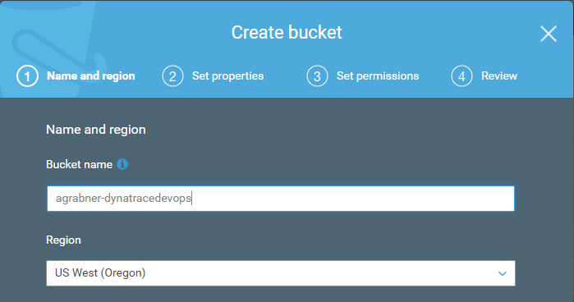
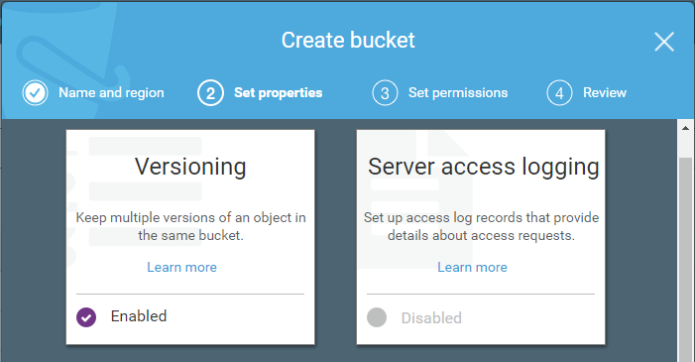
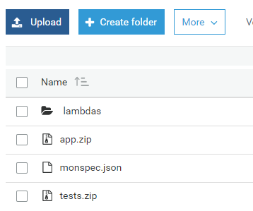
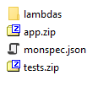
Before we get started – we need to copy some files
#1: Create a new S3 Bucket in your AWS Account with the name: <yourlastname>-dynatracedevops
#2: Upload all files (including lambda subfolder) from your C:\DynatraceAWSDevOps\copytos3 to this Bucket!
<yourname>-dynatracedevops
US West (Oregon)
Enable Versioning
Drag & Drop
or Upload

Slide 10
#1 Launching the CloudFormation Stack
What is CloudFormation?
A declarative way to define AWS Resources, e.g: EC2, CodeDeploy, CodePipeline, Lambda, Roles, ELBs, …
Learn more about CloudFormation: https://docs.aws.amazon.com/AWSCloudFormation/latest/UserGuide
Our Steps
Browse to https://github.com/Dynatrace/AWSDevOpsTutorial
Click on the CloudFormation Template Link for your region, e.g: Oregon (us-west-2) for this workshop!
This will open your CloudFormation web console for the correct region

Slide 11
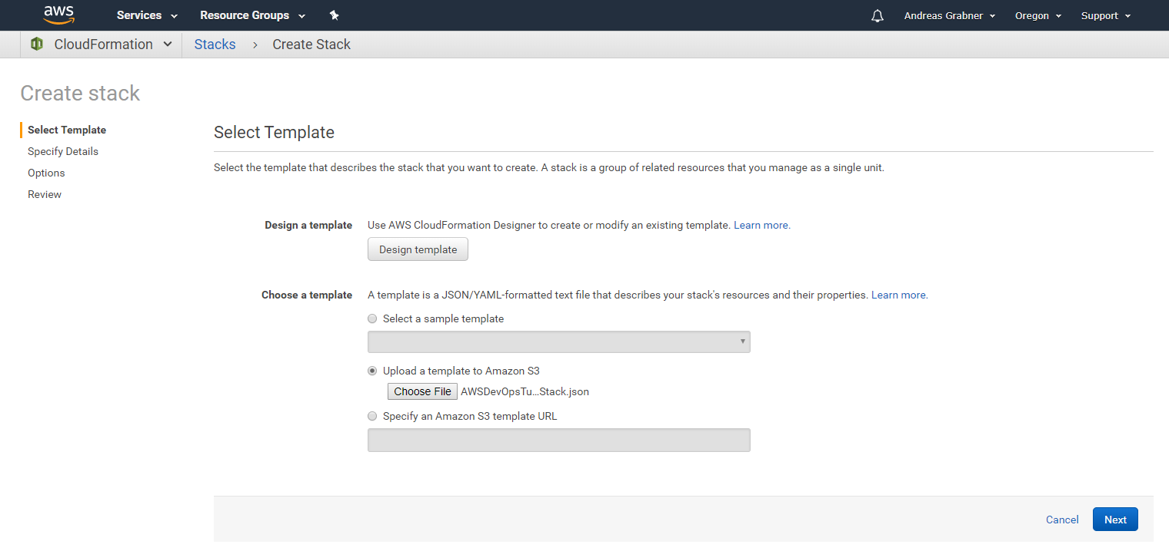
#2 Launching the CloudFormation Stack: Upload Template
#1 Oregon!
#2 Upload the AWSDevOpos…json
#3

Slide 12
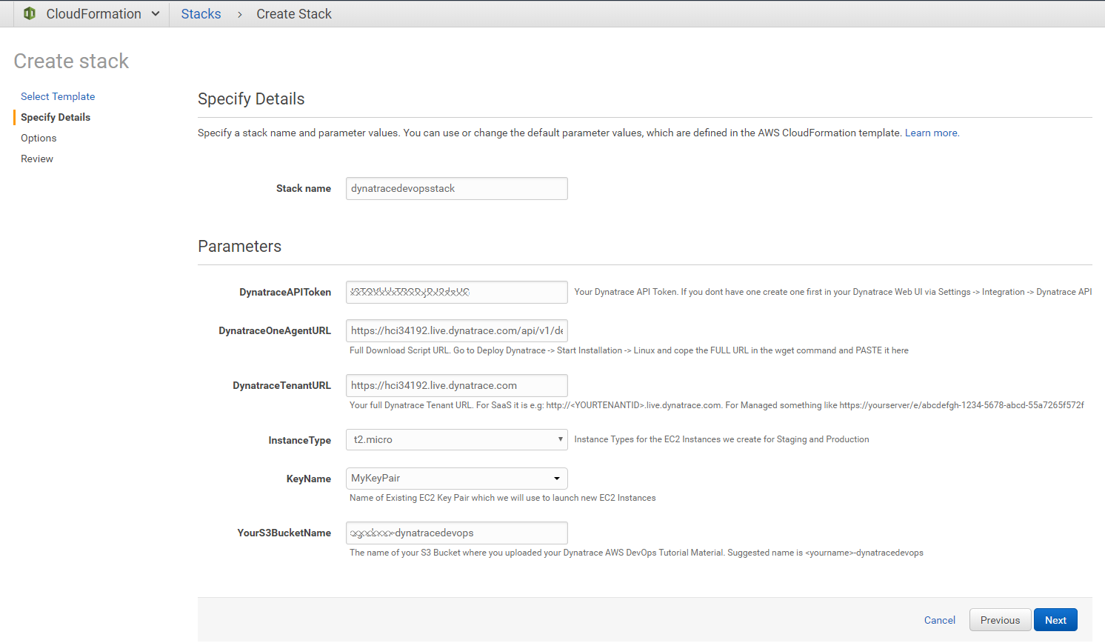
#3 Launching the CloudFormation Stack: Filling in the details
You can go with default!
Your Dynatrace API Token
The OneAgent Linux Download link
Your Dynatrace Tenant URL
Your AWS EC2 Key Pair
<yourname>-dynatracedevops
Next

Slide 13
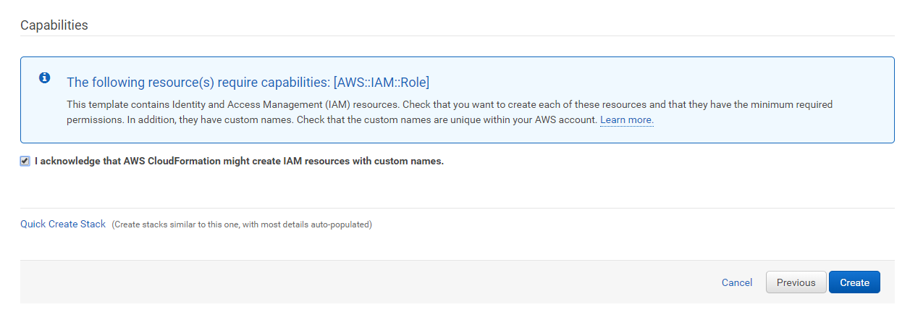
#4 Launching the CloudFormation Stack: Confirm and Create!
#1 Confirm
#2

Slide 14
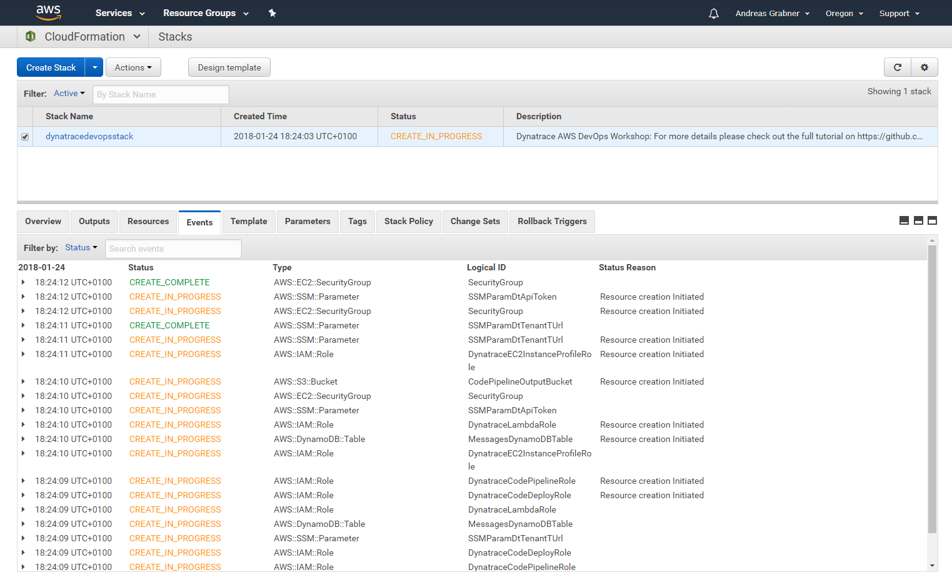
#5 Launching the CloudFormation Stack: Follow Events during Creation!
Watch as AWS Resources get created

Slide 15
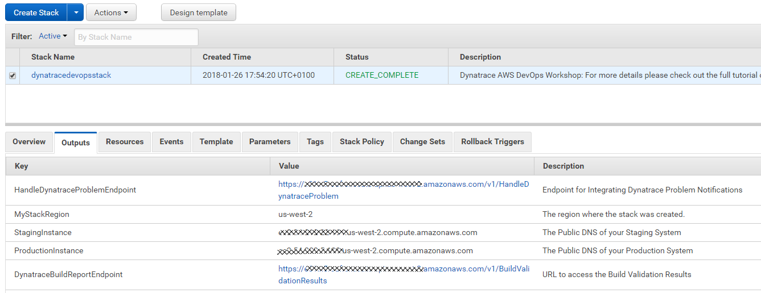
#5 Launching the CloudFormation Stack: DONE! Check Outputs!
#1 Once COMPLETE
#2 Check Outputs!
Will need these links later
Remember how to get here or copy them to local file

Slide 16
Exploring what we just created!

Slide 17
CloudFormation Template Created the following
2 EC2 Instances
1 that will run Staging and 1 that will run Production version of your app
Both EC2 Instance have a Dynatrace OneAgent installed sending data to your Dynatrace Tenant
AWS CodeDeploy
4 Deployment Configurations for our Sample App
AWS CodePipeline
A Pipeline with Source, Staging, Approval and Production stages
Several AWS Lambda Functions
Implement Dynatrace Automation Steps in our Pipeline, provide access to build results, handle Dynatrace Problem notification …
AWS User Roles and Policies
Allowing CodePipeline, CodeDeploy and Lambda to access other resources
System Manager Properties for DT_TENANT, DT_TOKEN, DT_BUILD_REPORT_URL

Slide 18
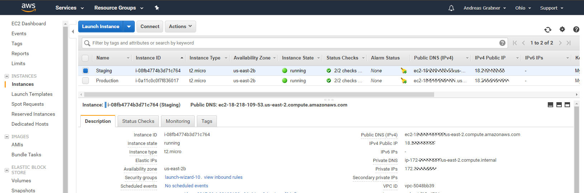
Explore our 2 EC2 Instances: Staging & Production
#1 Remote Connect for Troubleshooting
#3 AWS Name
& InstanceID’s
#2 Your Public DNS and IPs
#4 Automatically executed script!
UserData (not complete – check it out in the EC2 Web UI)
#1: Install Dynatrace OneAgent
yum update -y
yum install ruby wget -y
wget -O Dynatrace-OneAgent-Linux.sh "{{DynatraceOneAgentURL}}
sudo /bin/sh Dynatrace-OneAgent-Linux.sh APP_LOG_CONTENT_ACCESS=1
#2: Install Depending Software, e.g: httpd, nodejs, pm2
…
#3: Launch dummy PM2 App to pass Env Variables to OneAgent -> Trick to get Vars into Web UI
export DT_CUSTOM_PROP=DEPLOYMENT_GROUP_NAME=GROUP_NAME APPLICATION_NAME=APP_NAME
echo "console.log('dummy app run');" >> testapp.js
pm2 start testapp.js &> pm2start.log
#4: Install AWS CodeDeploy Agent and run CFN Update
…

Slide 19
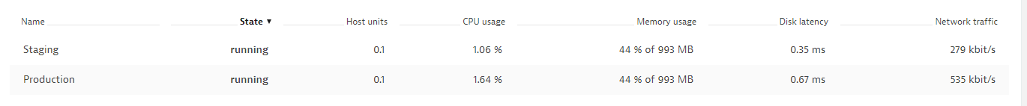
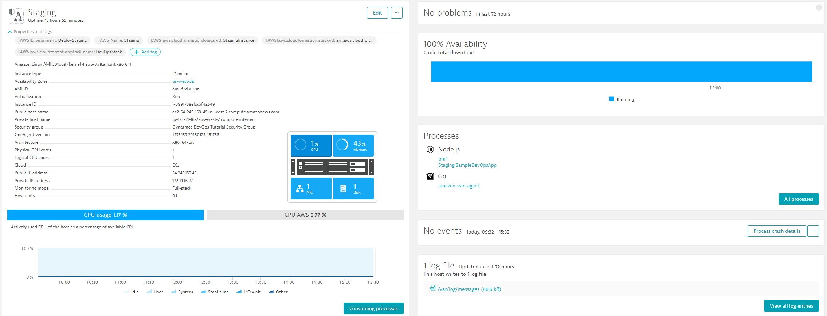
In Dynatrace Web UI: View Hosts and Validate monitored EC2 Instances
#1 If Dynatrace AWS CloudWatch Integration is configured you see EC2 Instance Name, otherwise EC2 Instance ID
#2 Click on a Host! FullStack Monitoring Dettails of each EC2 Instance

Slide 20
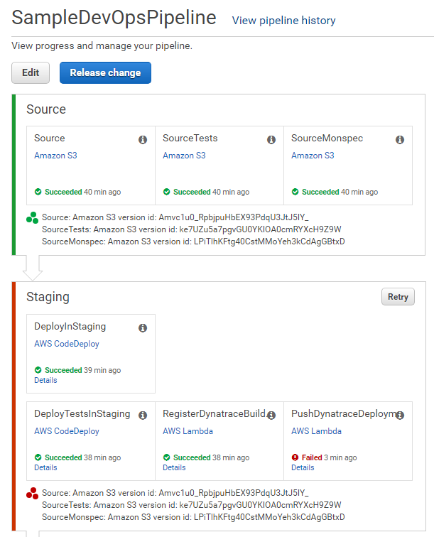
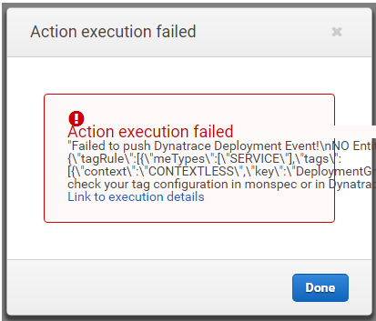
Explore AWS CodePipeline: First run already on its way but will FAIL!
#1 Open the SampleDevOpsPipeline
#2 Pipeline checks out Source,
SourceTests and Monspec from S3
#3 Uses CodeDeploy to deploy Node.js App on Staging EC2 with DT_TAGS, DT_X Env Variables
#7 FAILS: Because of Missing Tags in Dynatrace!
#5 Pushes Deployment Info to special tagged Dynatrace entities. Will FAIL!
#4 CodeDeploy also starts tests on the same machine

Slide 21
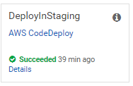
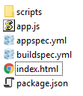
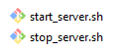
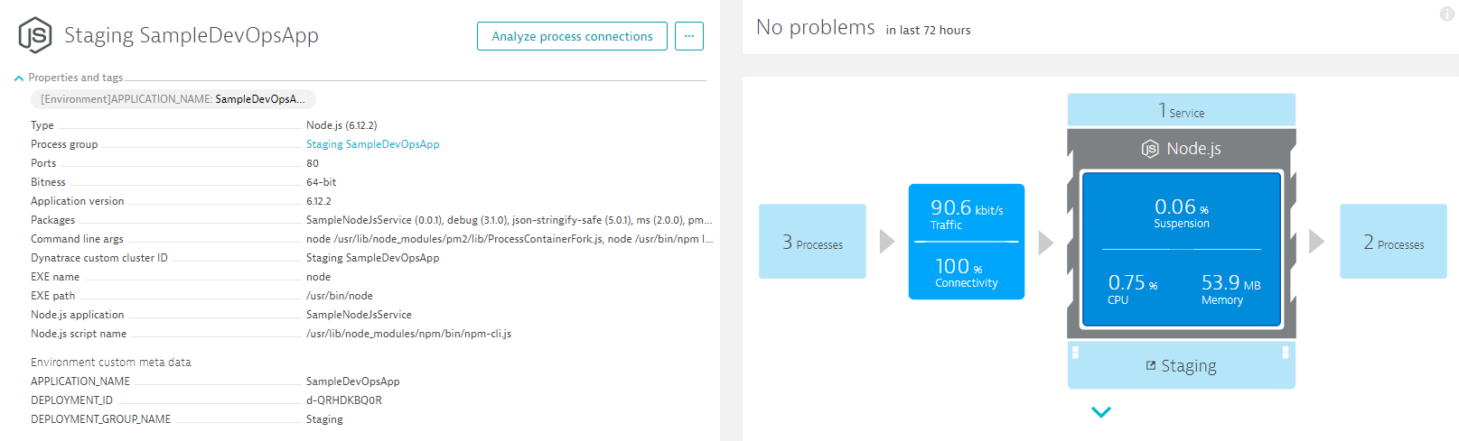
What does AWS CodeDeploy do during Deployment?
#1 Copies to EC2 & Extracts
#2 Executes start_server.sh:
export DT_TAGS=APPLICATION_NAME=$APPLICATION_NAME
export DT_CUSTOM_PROP="DEPLOYMENT_ID=$DEPLOYMENT_ID DEPLOYMENT_GROUP_NAME=$DEPLOYMENT_GROUP_NAME APPLICATION_NAME=$APPLICATION_NAME“
export DT_CLUSTER_ID="$DEPLOYMENT_GROUP_NAME $APPLICATION_NAME“
pm2 start app.js &> pm2start.log
#2 DT_CLUSTER_ID
#2 DT_TAGS
#2 DT_CUSTOM_PROP

Slide 22
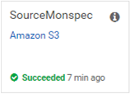
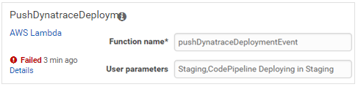

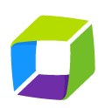
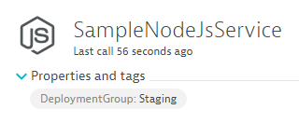
What does PushDynatraceDeploymentInfo do? And WHY can it FAIL?
Monspec (Monitoring as Code)
"SampleJSonService" : {
"etype": "SERVICE",
"environments" : {
"Staging" : {
"tags" : [
{
"context": "CONTEXTLESS",
"key": "DeploymentGroup",
"value": "Staging"
}
]
},
"Production" : {
"tags" : [
{
"context": "CONTEXTLESS",
"key": "DeploymentGroup",
"value": "Production"
}
]
}
},
pushDynatraceDeploymentEvent
Pulls Information from Monspec
Dynatrace Events REST API
Pushes Event for Entities with Tag DeploymentGroup:Staging

Slide 23
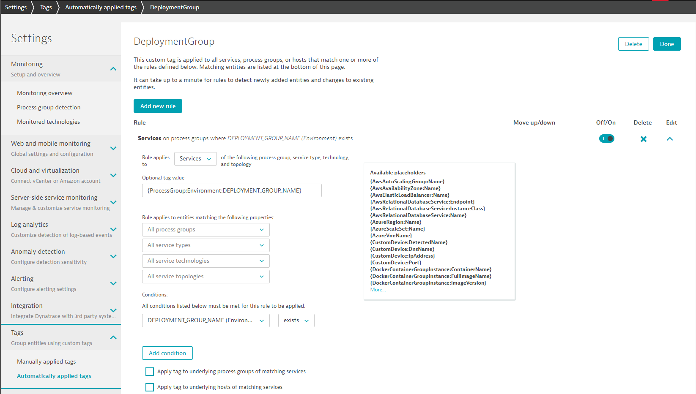
Configure Service Tagging Rules to Automatically apply Staging vs Production Tags
#2 – Call the Tag “DeploymentGroup”
#3 – For Services
#4– Tag Value comes from our Process Environment Variable
#5 – Only apply rule if env variable exists
#1

Slide 24
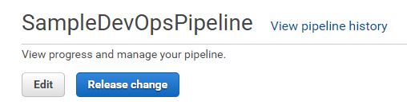
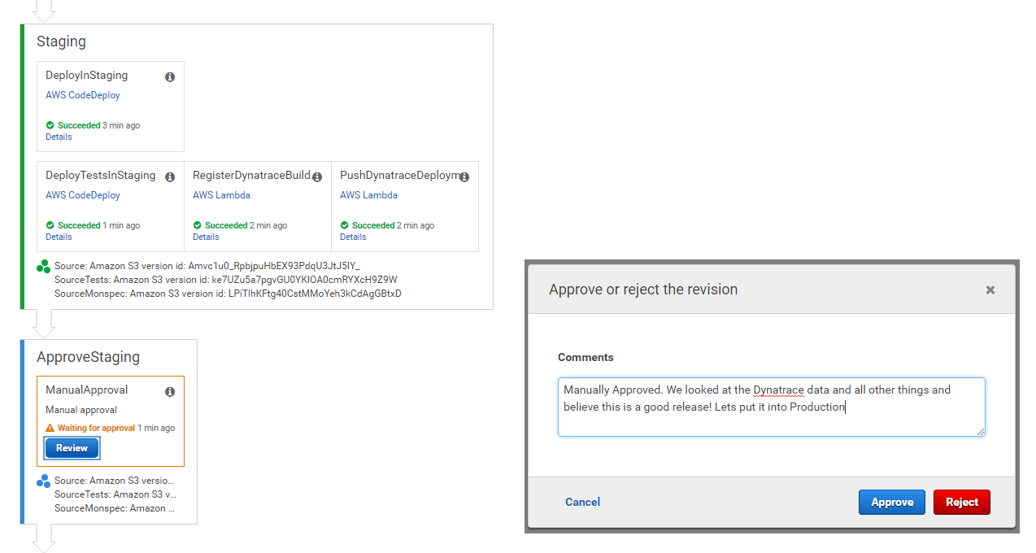
Lets Run the Pipeline Again: Should run through without a problem
#1 Click on “Release change”
#2 All should be green!
#3 Click on “Review”
#4 Lets Manually Approve it!

Slide 25
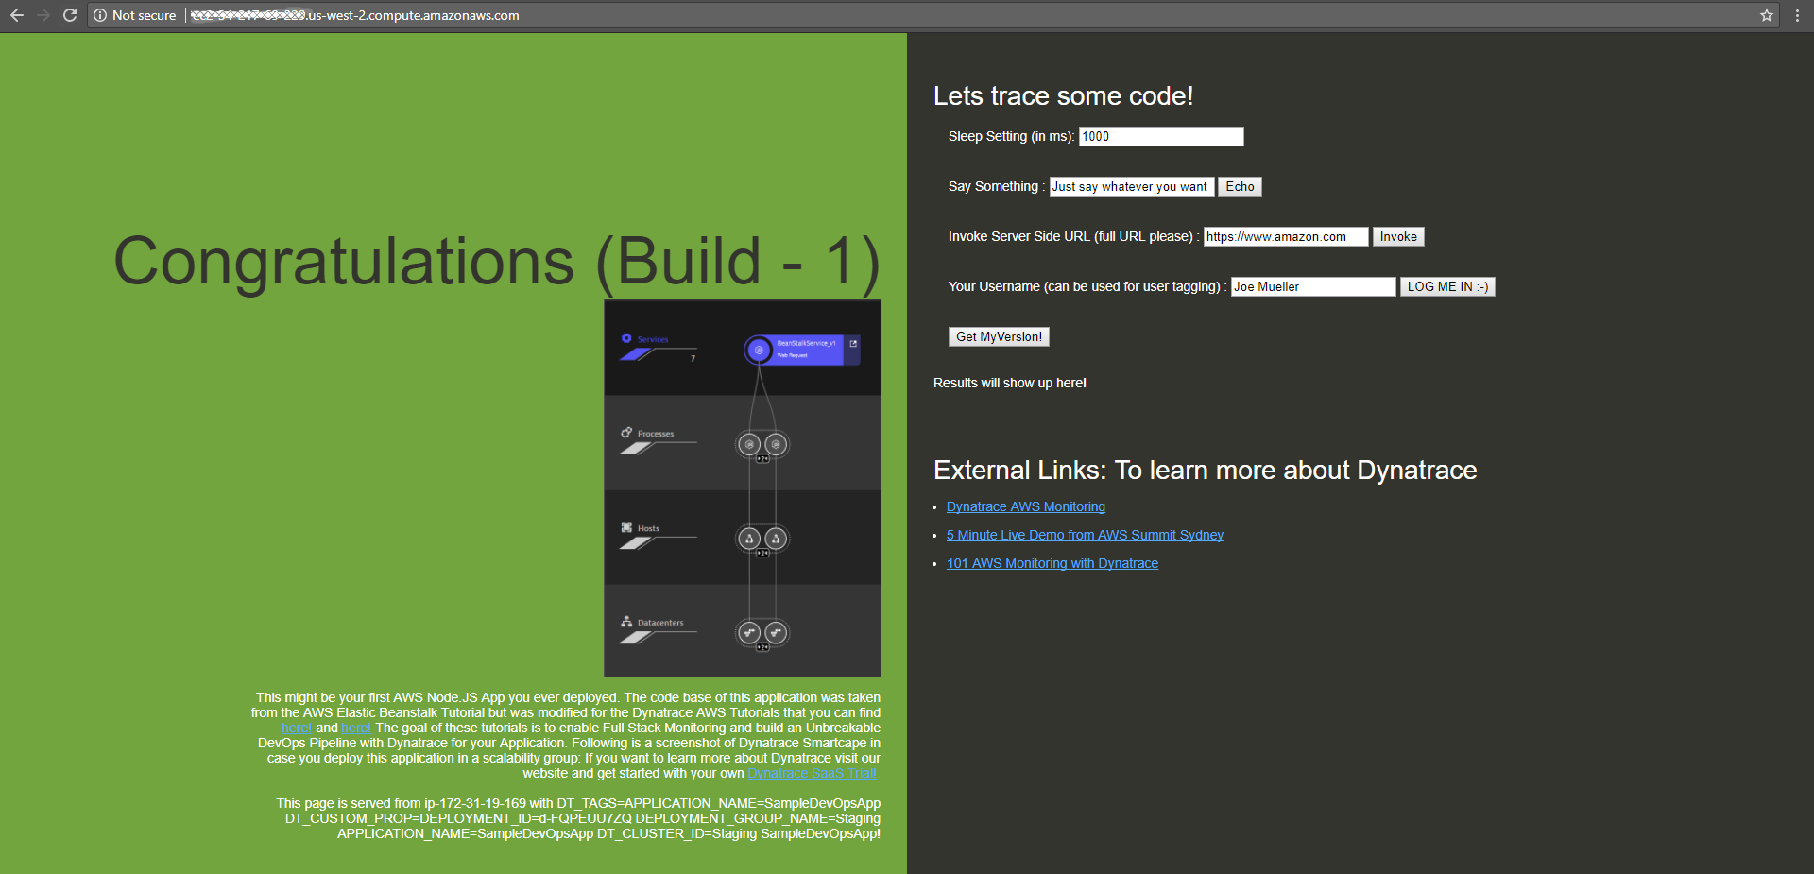
Lets Explore our Application in Staging: Not a Web UI Masterpiece – but it works ☺
In your Browser: http://YOURPUBLICDNSFORSTAGINGEC2INSTANCE.amazonaws.com

Slide 26
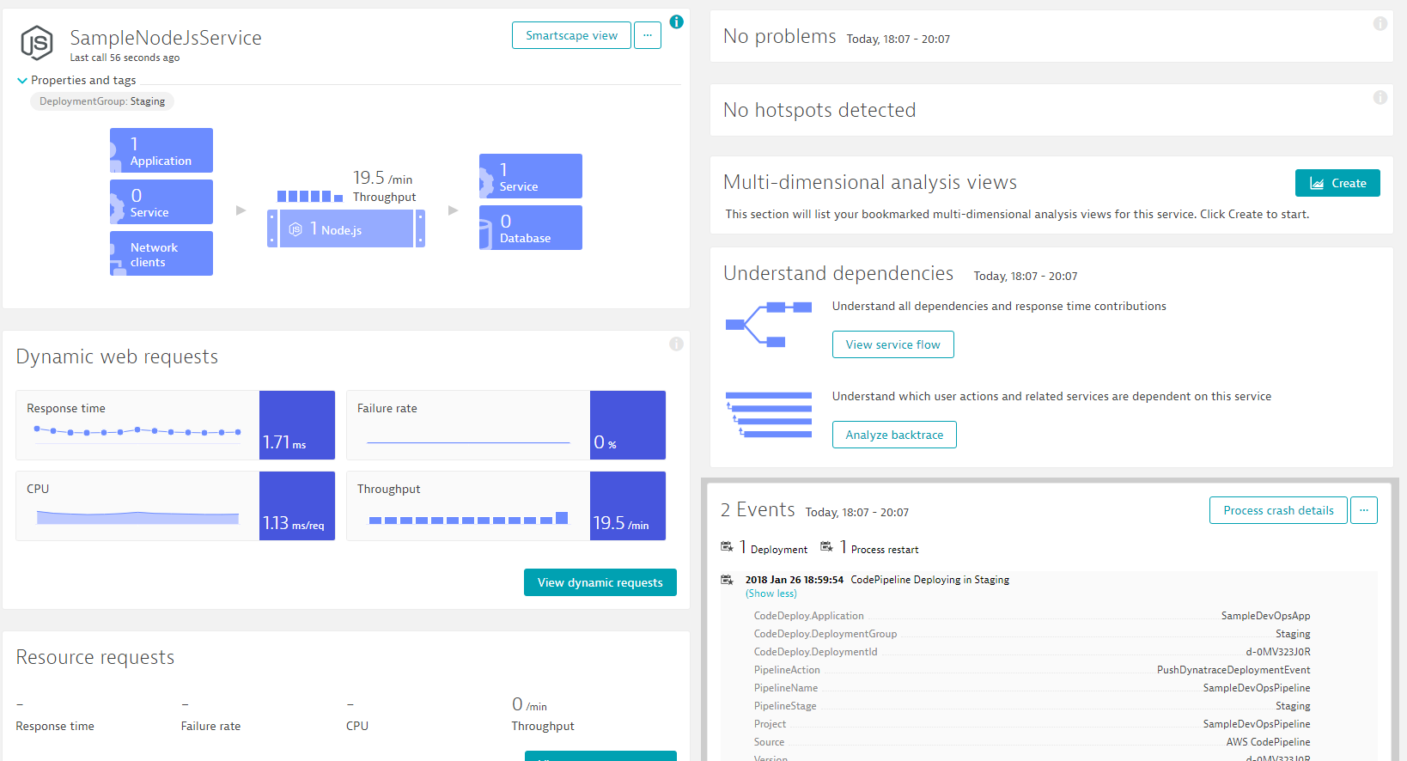
Explore our Services in Dynatrace: Everything Monitored, Everything Tagged
#1: Default Service Name from package.json
#2 Our DeploymentGroup tag
#3 Our Deployment Event
Crated by pushDynatraceDeploymentEvent

Slide 27
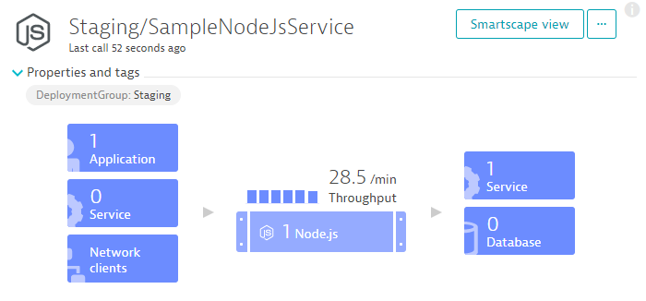
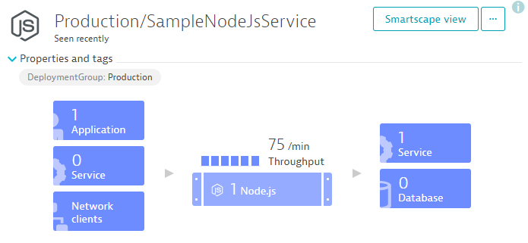
Same CodeDeploy scripts used for Staging & Production: We can validate in Dynatrace!
CodeDeploy runs start_server.sh during deployment:
export DT_TAGS=APPLICATION_NAME=$APPLICATION_NAME
export DT_CUSTOM_PROP="DEPLOYMENT_ID=$DEPLOYMENT_ID DEPLOYMENT_GROUP_NAME=$DEPLOYMENT_GROUP_NAME APPLICATION_NAME=$APPLICATION_NAME“
export DT_CLUSTER_ID="$DEPLOYMENT_GROUP_NAME $APPLICATION_NAME“
pm2 start app.js &> pm2start.log
Staging
Production
CodeDeploy runs stop_server.sh during cleanup:
pm2 stop all &> pm2stop.log
pm2 delete all &> pm2delete.log

Slide 28
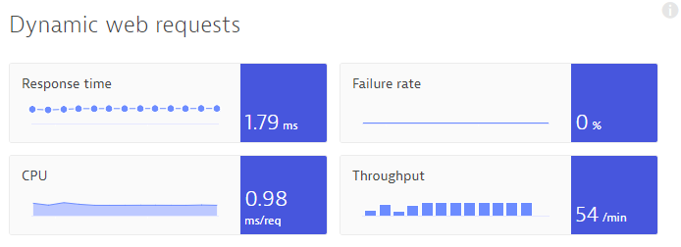
CodeDeploy also used to deploy a “Load Test”: Very Simple – I Know ☺
start_loadtest.sh:
rm -f ./endloadtest.txt &> loadtest.log
nohup ./loadtest.sh >/dev/null 2>&1 &
Test Runs until this file exists
loadtest.sh:
while [ ! -f ./endloadtest.txt ];
Do
curl -s "http://localhost/"
curl -s "http://localhost/version"
curl -s "http://localhost/api/echo?text=This is from a testing script"
curl -s "http://localhost/api/invoke?url=http://www.dynatrace.com"
done;
stop_loadtest.sh:
echo "stop test" >> ./endloadtest.txt

Slide 29
Now lets inject more Dynatrace into the Pipeline
#2 Automate Staging Approval through Continuous Performance Validation!

Slide 30
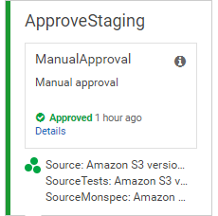
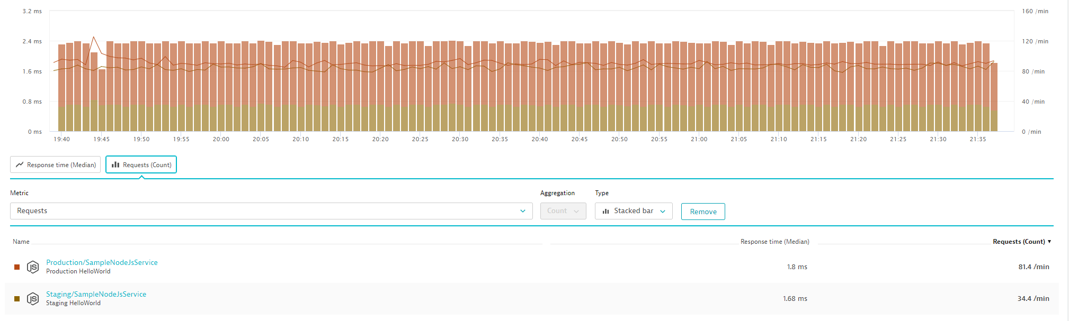
Manual Approval: #1 Compare Staging with Production
Timeframe: 30 Minutes after test started!
Environments: Staging & Production Tagged Services
Metrics: Response Time, Failure Rate

Slide 31
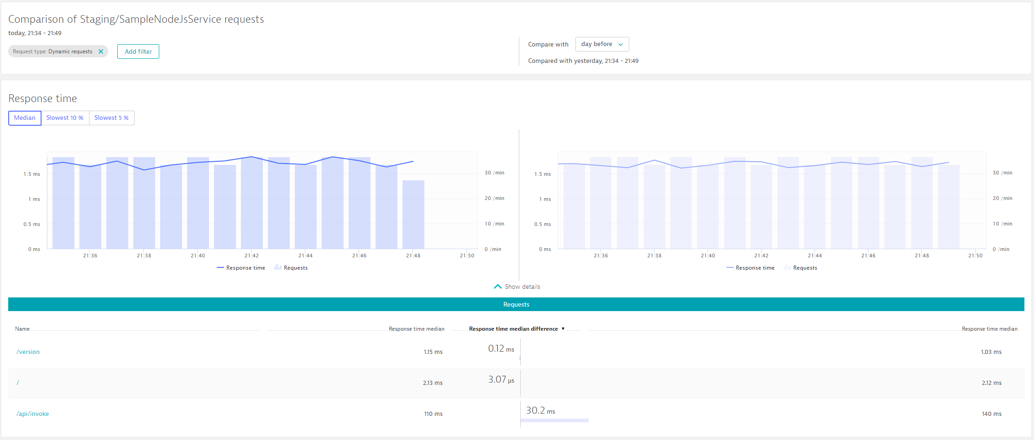
Manual Approval: #1 Compare Staging with Staging Yesterday!
Environment: Just Staging vs Staging
Timeframe: First 15 Minutes of Test
Compare Timeframe: with 15 Minutes of previous day
Metrics: Response Time, Failure Rate …

Slide 32
Manual is boring!
And – yeah – not automated!

Slide 33
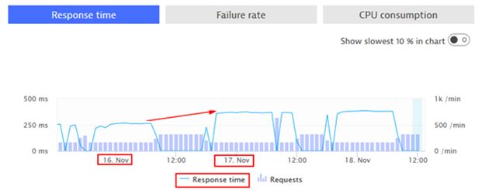
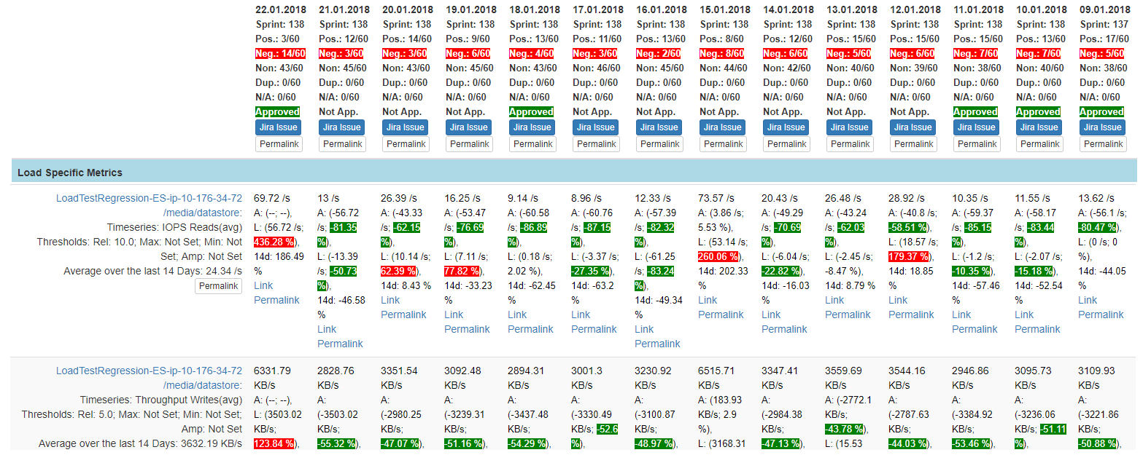
Continuous Performance: Inspired by Dynatrace Performance Architect Team
“Performance Signature” for Build Nov 16
“Performance Signature” for Build Nov 17
“Performance Signature” for every Build
“Multiple Metrics” compared to prev Timeframe
Simple Regression Detection
per Metric

Slide 34
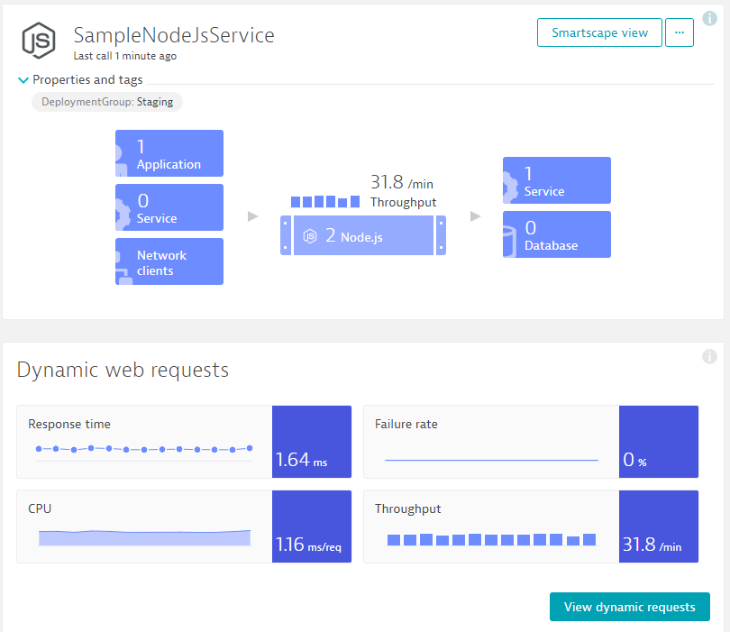
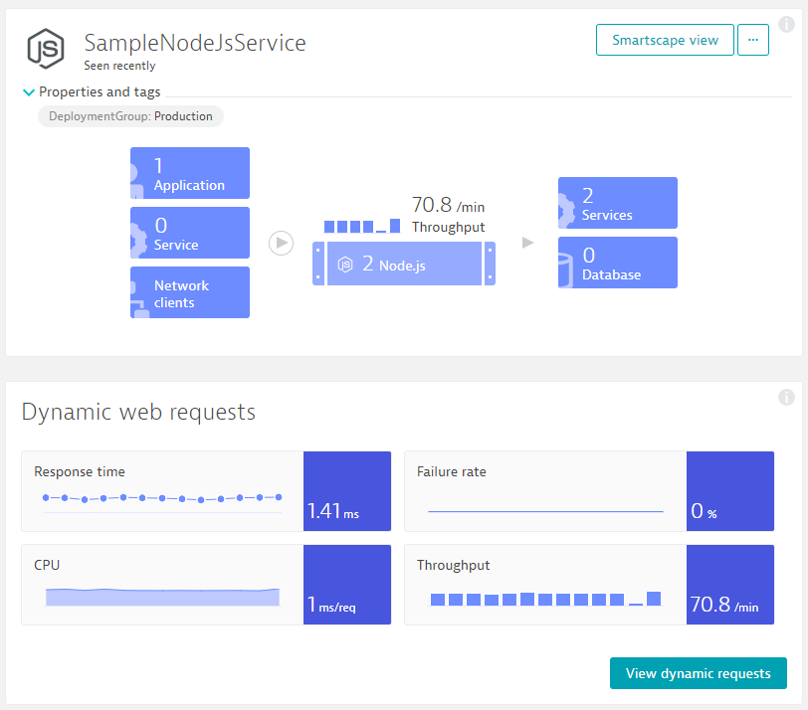
“Monspec”: Performance Signature as Code for Continuous Performance Validation
Entity: SampleJSonService
Different Metrics
Environment: Staging
Tag: DeploymentGroup:Staging
Environment: Production
Tag: DeploymentGroup:Production
Metrics: ResponseTime (Avg)
Metrics: ResponseTime(Max) < 10s
Metrics: FailureRate(Avg)
Metrics: ResponseCount
Factor: 90% Less vs Production
Different Comparisons
Compare: StagingToProduction
Source: Staging; Compare: Prod
Factor: Staging = 10% Slower
Compare: StagingToProdYesterday
Source: Staging; Compare: Prod
Factor: 10%, Timeshift: 86400s
Compare: StagingToStagingLastHour
Source: Staging; Compare: Staging
Factor: 0; Timeshift: 3600s
Compare: StageToStageYesterday
Source: Staging; Compare: Staging
Factor: 0; Timeshift: 86400s
Pipeline Run: Validate Build with StagingToProduction
Source (Staging): 1.64ms
Environment: Staging
Environment: Production
Compare (Production): 1.41ms
Threshold (+10%): 1.56ms
Status: VIOLATION

Slide 35
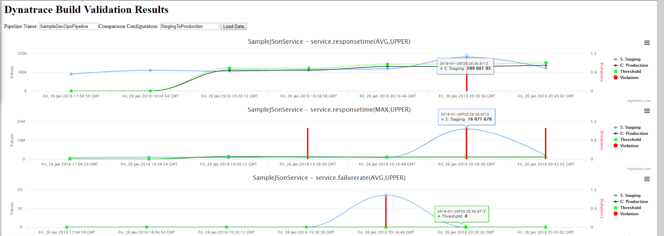
“Monspec”: Continuous Build Validation in Action across Pipeline runs!
Comparisons
Entity
Metrics
Environment
Run #1
Run #2
Run #3
Run #4
Run #5
Run #6
Run #7

Slide 36

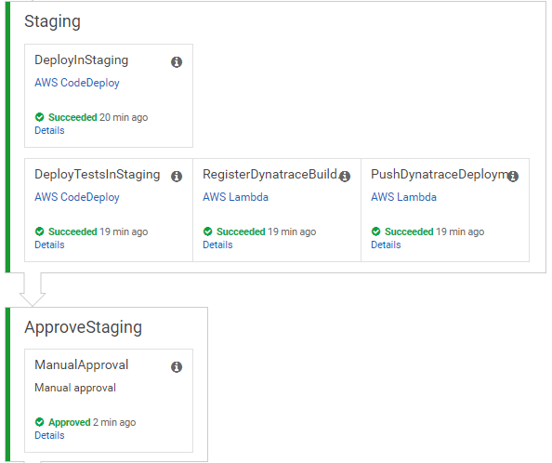
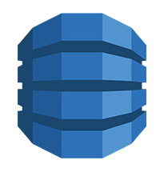

Integrating with AWS CodePipeline
Monspec from S3
Staging: Register Build Validation!
Build Validation Request Item
Pipeline Information
Monspec
Timestamp + Timeframe
Comparison Definition Name
Adds Item
registerDynatraceBuildValidation
Adds Build Validation Request
Updates Build Validation Request
Updated Monspec
UpdatedStatus
Approves/Rejects IF “In Progress” & Comment Field contains name of RegisterBuildValidation Action
triggers
validateBuildDynatraceWork
CloudWatch Events
(e.g: 1min)
Dynatrace Entities & Timeseries REST API
Resolves Tags and gets list of Entities
Queries Metrics for these Entities

Slide 37
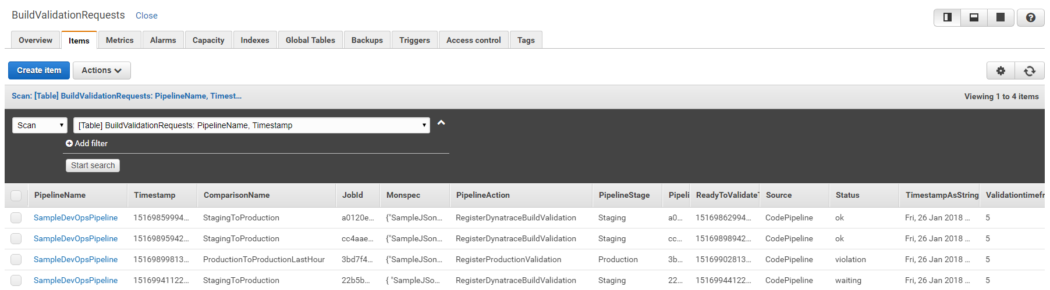
Build Validation: Explore DynamoDB BuildValidationRequest Table
Comparison Configuration to use
Action that sent request!
Used for “Link with Approve”
When can WorkerJob validate the data?
PipelineName
Full Monspec
Status

Slide 38
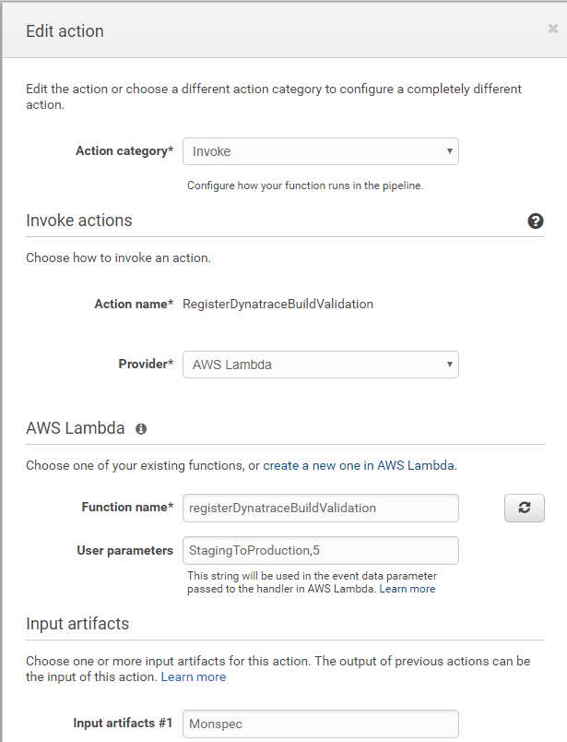


Build Validation: Explore “Register Build Validation”
Invoke
RegisterDynatraceBulidValidation
AWS Lambda
registerDynatraceBuildValidation
StagingToProduction,5
Monspec

Slide 39


Build Validation: “Link” Approval with Build Validation: Edit Approval and add Comment
RegisterDynatraceBuildValidation

Slide 40

Build Validation: Explore “AWS CloudWatch Rule”
#1 Rule was created by CloudFormation
#2 every 2 minutes
#3 executes this Lambda

Slide 41
Now lets run some builds!
#3 Testing our Staging Validation Process

Slide 42


Lets execute another build and test the automatic approval
TIP: Want to approve a rejected Build?
“Retry” stage and manually approve

Slide 43

Explore the Build Validation Report
Open in Browser: http://YOURAPIGATEWAY.amazonaws.com/v1/BuildValidationResults

Slide 44
Simulating Different “Bad” Builds
Application looks for Env variable BUILD_NUMBER during startup. Allowed values, 1, 2, 3, 4
Build Number | Behavior
1 | No Problem
2 | 50% of requests return HTTP 500
3 | No Problem
4 | Staging OK. 10% Requests fail in Production
To Deploy a different build:
From appbuilds_readytodeploy\app_buildX.zip rename to app.zip
Upload app.zip and overwrite existing app.zip in your S3 bucket
In your AWS CodePipeline click on “Release change”

Slide 45
Lets Deploy Build 2 and Build 3
Every full CodePipeline Run may take up to 15 Minutes
Lets see if Staging gets approved or if we have problems
If the approval stage gets rejected – check the details and open the link to the overview report
If you don’t want to wait you can manually approve a stage. Build Validation will still happen behind the scenes and results will be posted back to DynamoDB
After you have run a couple of builds you should see more data in your Build Validation Report!

Slide 46
Background on “Monitoring as Code” – Introducing “monspec.json”
monspec.json
{
"SampleJSonService" : {
"etype": "SERVICE", // "Options are SERVICE, APPLICATION, HOST, PROCESS_GROUP_INSTANCE"
"name": "SampleNodeJsService",
"environments" : {
"Staging" : {
"tags" : [
{
"context": "CONTEXTLESS",
"key": "DeploymentGroup",
"value": "Staging"
}
]
},
"Production" : {
"tags" : [
{
"context": "CONTEXTLESS",
"key": "DeploymentGroup",
"value": "Production"
}
]
}
},
Entity: What Entity do we want to validate?
Environments: Tell us how we can detect these entities in Dynatrace

Slide 47
Background on “Monitoring as Code” – Introducing “monspec.json”
Comparision: Which environments do we compare and how!
monspec.json
{
"SampleJSonService" : {
...
"comparisons" : [
{
"name" : "StagingToProduction",
"source" : "Staging",
"compare" : "Production",
"scalefactorperc" : {
"default": 10,
"com.dynatrace.builtin:service.requestspermin" : 90
},
"shiftcomparetimeframe" : 0,
"shiftsourcetimeframe" : 0,
},
{
"name" : "StagingToProductionYesterday",
"source" : "Staging",
"compare" : "Production",
"scalefactorperc" : {
"default": 10,
"com.dynatrace.builtin:service.requestspermin" : 90
},
"shiftsourcetimeframe" : 0,
"shiftcomparetimeframe" : 86400
}
monspec.json
{
"SampleJSonService" : {
...
"comparisons" : [
{
"name" : "StagingToStagingLastHour",
"source" : "Staging",
"compare" : "Staging",
"scalefactorperc" : { "default": 0},
"shiftsourcetimeframe" : 0,
"shiftcomparetimeframe" : 3600
},
{
"name" : "ProductionToProductionLastH",
"source" : "Production",
"compare" : "Production",
"scalefactorperc" : { "default": 0},
"shiftsourcetimeframe" : 0,
"shiftcomparetimeframe" : 3600
}
],

Slide 48
Background on “Monitoring as Code” – Introducing “monspec.json”
monspec.json
{
"SampleJSonService" : {
...
"perfsignature" : [
{
"timeseries" : "com.dynatrace.builtin:service.responsetime",
"aggregate" : "avg", // min, max, avg, sum, median, count, percentile
"validate" : "upper", // upper or lower
// "upperlimit" : 100, // Optional: Can be used to define a FIXED THRESHOLD
// "lowerlimit" : 50, // Optional: Can be used to define a FIXED THRESHOLD
},
{
"timeseries" : "com.dynatrace.builtin:service.responsetime",
"aggregate" : “p90"
},
{
"timeseries" : "com.dynatrace.builtin:service.failurerate",
"aggregate" : "avg"
},
{
"timeseries" : "com.dynatrace.builtin:service.requestspermin",
"aggregate" : "count",
“validate" : "lower"
}
],
Metrics: Which Metrics, Aggregation, Upper/Lower Boundaries

Slide 49
Handling Problems in Production
#4 Configure Incident Management

Slide 50






Problem Notifications, Escalation & Triage Process

Slide 51


Alerting Profiles: Better Notification Management
Dynatrace Alerting Profiles
Create for Production and Staging
#2
#3
#4: Select tag for all Alert Types
#1

Slide 52
xMatters Integration Configuration
Dynatrace – xMatters Integration
Set it up for Production Alerting Profile!
See xMatters and Dynatrace Integration Deck for these steps!
When setting up the Notification select the “Production” Alerting Profile we just created
For more information also see
Watch the video here: https://www.youtube.com/watch?v=jNEBLGfOxcg
Details on the integration: https://github.com/xmatters/xm-labs-dynatrace
More xMatters Integrations: https://xmatters.com/integrations

Slide 53
Lets simulate a Problem: Switch to Build #4
Option #1: Run a full Pipeline with Build #4
Take build4/appdeploy.zip and upload it to your S3 Bucket
This will trigger a full AWS CodePipeline Run which will Deploy Build #4
This will take about 5-10 minutes to run the Pipeline and Another 5 Minutes until Problem is triggered
Option #2: Switch the Build “on the fly”
Navigate to http://YOURPRODUCTIONAPP/api/version?newBuildNumber=4
This will only take about 5 Minutes until Problem is detected
Switch back to Build #1 once problem was detected
Navigate to http://YOURPRODUCTIONAPP/api/version?newBuildNumber=1
Problem ticket should close within a couple of minutes!

Slide 54
Self-Healing Problems in Production
#5 Configure Auto Remediation Scripts

Slide 55




Self-Healing: Rollback Scenario with AWS Lambda and AWS CodeDeploy
Push Deployment Information, e.g: CodeDeploy DeploymentId
Uses Dynatrace Events API
to pull CUSTOM_DEPLOYMENT events
Calling Lambda via API Gateway
Redeploy previous revision
handleDynatraceProblemNotification

Slide 56




Configure the Integration
#4 - Any Name
#5 – Your Endpoint
#1
#2
Required Fields PID and ImpactedEntities
#3
#6 Alert Profilg
#7: Test & Save

Slide 57
Lets simulate a Problem: Switch to Build #4
Option #1: Run a full Pipeline with Build #4 (would suggest this option!)
Take build4/appdeploy.zip and upload it to your S3 Bucket
This will trigger a full AWS CodePipeline Run which will Deploy Build #4
This will take about 5-10 minutes to run the Pipeline and Another 5 Minutes until Problem is triggered
Option #2: Switch the Build “on the fly”
Navigate to http://YOURPRODUCTIONAPP/api/version?newBuildNumber=4
This will only take about 5 Minutes until Problem is detected
Once Problem is detected!
Will Trigger an xMatters Notification
Will Trigger the AWS Lambda Remediation Action which will trigger an AWS CodeDeploy Deployment

Slide 58
More Information
Watch out for updates on https://github.com/Dynatrace/AWSDevOpsTutorial
Dynatrace REST API: https://www.dynatrace.com/support/help/dynatrace-api/

Slide 59
Optional Steps

Slide 60

Service Naming Rules: Distinguish services between Staging and Production
#2
#3
DEPLOYMENT_GROUP_NAME/Detected ServiceName
#1
Only when DEPLOYMENT_GROUP_NAME exists

Slide 61
Here is the result! Nicer Service Names!

Slide 62

Log Rule Events: Automated Problem Detection based on custom Log Messages
#1 Access Log Files

Slide 63

Log Rule Events: Automated Problem Detection based on custom Log Messages
Error Log Messages. You can simulate them by executing /api/causeerror

Slide 64

Log Rule Events: Automated Problem Detection based on custom Log Messages
#1 Define filter for that log message
#3 Define Event
#2 Validate filter works (click on Display Log first)

Slide 65

Log Rule Events: Automated Problem Detection based on custom Log Messages
#1 Define a Name
#2 Create Log Problem if we have more than 0 occurences
#3 Select log file from Production and Staging
#4 Save

Slide 66

Log Rule Events: Automated Problem Detection based on custom Log Messages
#1 Browse to /api/causeerror
That should open a problem ticket!

Slide 67
Cleaning Up

Slide 68


Deleting the Stack: Otherwise you will see costs the longer your environment runs!
When deleting the stack and a Pipeline run was executed it will end up in
Because CodeDeploy pushed files into S3
Two steps to completely remove the Stack
Go to S3 and delete the bucket called: codepipeline-artifacts-<yourname>-dynatracedevops
Run a second Delete Stack Action and confirm that the S3 Bucket remains

Slide 70
xMatters Slides

Slide 71
xMatters and Dynatrace integration
With optional bonus Jira integration

Slide 72
What is xMatters and What can it add to Dynatrace?
Find the right person at the right time to quickly start troubleshooting Dynatrace Problems
Use Voice, Email, SMS and even Mobile Push to reach out to people
Audit log of who was notified in Dynatrace
Create a Jira ticket with Dynatrace information (optional)
Watch the video here: https://www.youtube.com/watch?v=jNEBLGfOxcg
Details on the integration: https://github.com/xmatters/xm-labs-dynatrace
More xMatters Integrations: https://xmatters.com/integrations

Slide 73
Integration Installation and Configuration Overview
Generate Dynatrace Token
Create xMatters Trial Instance
Import Dynatrace Comm Plan
Configure xMatters
Create Dynatrace Webhook
Test!
Optional Jira integration

Slide 74
Generate Dynatrace Token Value
4
2
5
1
3

Slide 75
Download Dynatrace Communications Plan
https://github.com/xmatters/xm-labs-dynatrace/raw/master/Dynatrace.zip

Slide 76
Create xMatters Trial Instance
Click the url below and enter the appropriate details:
https://www.xmatters.com/p1/xmatters-trial-it-standard?utm_campaign=70138000001F018AAC&utm_source=dyna&utm_medium=email&utm_content=xmatters-trial

Slide 77


Import Communications Plan
1
2

Slide 78


Set Recipients
1
2
3

Slide 79


Set Recipients
1
2

Slide 80

Update Dynatrace Endpoint
2
1
3

Slide 81
Update Dynatrace Token Value
2
1
3

Slide 82
Get iuser password
1
2
3

Slide 83
Get iuser password
1
2

Slide 84

Copy Target URL
1
2
3
4

Slide 85
Copy Target URL
Target URL
1

Slide 86

Create Dynatrace Webhook
3
1
1
2

Slide 87

Create Dynatrace Webhook
Target URL
{
"ImpactedEntity": "{ImpactedEntity}",
"PID": "{PID}",
"ProblemDetails": "{ProblemDetails}",
"ProblemID": "{ProblemID}",
"ProblemImpact": "{ProblemImpact}",
"ProblemTitle": "{ProblemTitle}",
"ProblemURL": "{ProblemURL}",
"State": "{State}",
"Tags": "{Tags}"
}

Slide 88

Test!

Slide 89
Optional Jira Cloud Integration
This is an optional addition to the Dynatrace and xMatters integration. This adds the ability to create a Jira Issue from the xMatters notification.

Slide 90


Create Outbound Integration for Jira
1
2

Slide 91

Create Outbound Integration for Jira

Slide 92

Create Outbound Integration for Jira
2
1

Slide 93


Update Project Key and Issue Type to Match Jira
1
1
2
2

Slide 94



Add a Response Option
1
2

Slide 95

Add Jira Endpoint
1
2
3

Slide 96
Create xMatters User in Jira
https://confluence.atlassian.com/jira064/add-users-720412930.html

Slide 97




Test!

Slide 98
BACKUP / BACKGROUND

Slide 99
Create Instance Profile IAM Role
https://docs.aws.amazon.com/codedeploy/latest/userguide/getting-started-create-iam-instance-profile.html#getting-started-create-iam-instance-profile-console
This is the Role that is used to execute code within the EC2 Instance, e.g: Execute the AWS CodeDeploy Scripts
Create Service Role IAM Role
This Role is needed to let CodePipeline or CodeDeploy execute and access other AWS Resources & Actions
We need one for our CodeDeploy/CodePipeline as well as one for Lambda
Create DynamoDB Tables for BuildValidationRequests and one for ContinuousPerformanceBuildData
Create 2 EC2 Instances
Create Lambda Functions
Create CodeDeploy and CodePipeline

Slide 100
Troubleshooting Information
CodeDeploy
/opt/codedeploy-agent/deployment-root
<DEPLOYMENT-ID>/<REVISION-ID>

Slide 101


Slide 102

Dynatrace Configuration
Log Event for *.error.* -> only needed if App is not writing .log file in a “normal” way, e.g: when app is always closing log stream Dynatrace doesn’t automatically pick it up
Alerting Profiles for Staging & Production

